Slide 1
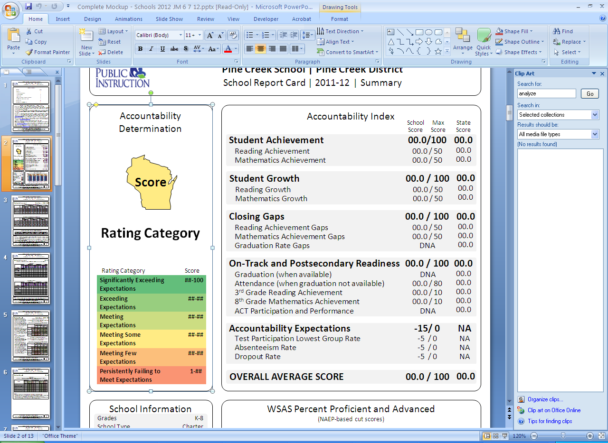

Understanding the New
School Report Card
Notes:
Greetings from CESA 10. CESA 10 is an educational service agency that provides support to your school district. My name is Nancy Forseth and I have prepared a brief presentation to help explain the new school report card that your school will be receiving on October 22nd.

Slide 2

Education Is Changing
45 States and 3 territories have adopted the Common Core State Standards
GOAL: ALL students will be college and career ready
Notes:
First of all, I want to provide some brief background to explain why our state has new school report cards. If the US is going to keep up with other countries, our education system needs to change. These new standards in Englis/LA and Math increase the expectations for learning for our students.

Slide 3
Wisconsin’s
New Accountability System
To help parents understand
how their child’s school is doing and
where it can improve
To help schools get a better
picture of how well they help
children learn
Notes:
In response to the increased expectations for learning, Wi has created a new accountability system The purpose… the new school report card will give each school a score that will fall into a category that ranges from Significantly Exceeding Expectations to Persistently Failing to Meet Expectations. The majority of schools will fall into the Meeting Expectations Category.

Slide 4
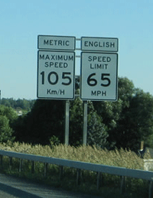
The New Report Card Uses a New Scale
Notes:
One of the important changes in the new accountability system is the change is the scale that is used to measure the achievement of our students. In Canada, the speed limit is 105. In the US it is 65. You are driving the same speed- the difference is the scale or how that speed is measured.

Slide 5
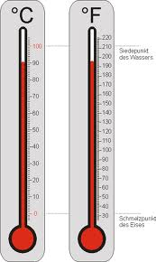
The New Report Card Uses a New Scale
Notes:
Differences in scale are also evident in the weather, If you are planning a trip to Paris and you you check the daily temperature, it might be 23 degrees which seems cold; but once again, it is a matter of scale. 23 degrees Celsius is 75 degrees Farenheit

Slide 6
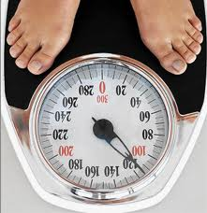
The New Report Card Uses a New Scale
Notes:
In addition to the change in scale, there will also be a change in expectations with a new assessment that will measure the new standards. The new and more rigorous assessment will start in the 2014-15 school year. For right now; however, we have the same students, taking the same tests, and performing the same. What has changed is the scale.

Slide 7
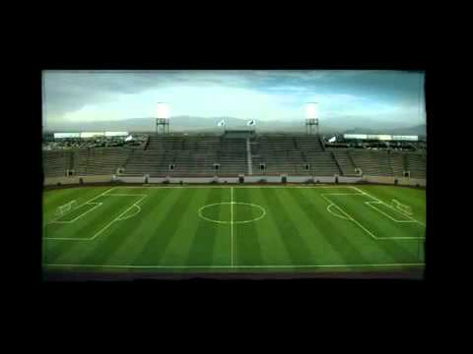
Scale Makes a Difference
The School Report Card uses a different scale to measure our students:
  Wisconsin had lower proficiency standards than other states
  Now, Wisconsin schools will be measured using a scale that is common across the country. This scale is based on the National
  Assessment of Education
  Progress (NAEP)
Notes:
That means that under the old system, students who were identified as proficient or advanced in WI, would not have been proficient in other states.
We are leveling the playing field. Now, one state can be compared to another state in terms of student performance.

Slide 8
What does this new scale mean?
2011-12 Subject | CESA 10 School Proficient & Advanced | State P & A | New State
All Reading | 81.5% | 81.9% | 37.9%
All Math | 75.9% | 78.0% | 49.8%
Notes:
In 2011-12, in a typical CESA 10 school 81.5% of the students might have been proficient or advanced in reading under our old system, and 75.9% might have been proficient or advanced in math. In our state as a whole, 81.9% of our students were proficient or advanced in reading and 78.8% were proficient or advanced in math. If we look at the same performance, by the same children, on the same test, but use the new scale, only 37.9% of WI students are proficient or advanced in reading and 49.8% proficient or advanced in math. At first glance, it may seem that our school is dropping in terms of performance, but it is not. Remember, it is the same performance, by the same children, on the

Slide 9
What does this new scale mean?
Group | 4th Grade Percent Proficient & Advanced |  | 8th Grade Percent Proficient & Advanced
 | Mathematics | Reading | Mathematics | Reading
Wisconsin | 47% | 34% | 41% | 34%
Nation | 40% | 32% | 34% | 32%
Notes:
Using the new NAEP scale, this table shows how our state compares to other students in the nation. Under our old system, we would not have been able to make this comparison. As you can see, at both 4th and 8th grades, Wi students perform higher. You can also see that there is room for improvement for everyone and this is why we now have the new state standards and why we will soon have a new state test.

Slide 10

What does this new scale mean?
We are measuring the same achievement
Same curriculum
Same students
We are using a new scale that compares Wisconsin schools to other states.

Slide 11
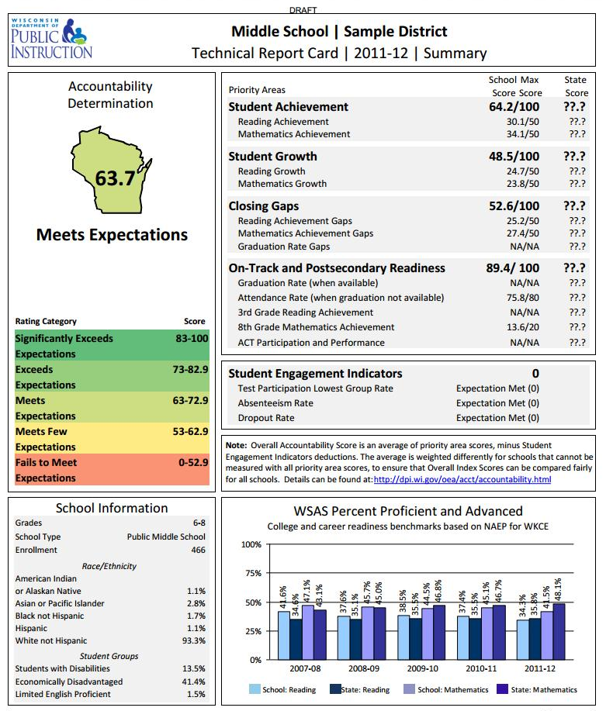
Components:
1. Accountability Determination
2. Priority Areas
3. Student Engagement Indicators
4. School Information
5. WSAS Percent Proficient and Advanced
2
1
3
4
5
Notes:
So, this is what the new school report card will look like……

Slide 12

What does the report card measure?
Priority 1: Student Achievement
Priority 2: Student Growth
Priority 3: Closing the Gaps
Priority 4: On Track/Post-Secondary Readiness
Test Participation
Absenteeism
Dropout Rate
Notes:
So in review,

Slide 13
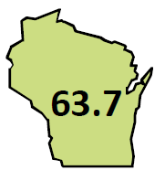
What does the accountability score mean?
Reflects many measures
It is NOT a percent correct
measurement, so these scores
are NOT the same as grades
Notes:
The final score reflects many measures. In this case, 63.7 means this school is meeting expectations, just like the majority of schools in our state.

Slide 14

As a parent, how can you use this information?
Discuss the report card at Parent/Teacher Conferences. How can you help your child improve?
Ask school staff to sponsor a parent meeting to discuss your school’s areas of strength and areas of need.
  What steps is the school taking to help students improve?
  How can parents help?

Slide 15
As a parent where can you get more information?
dpi.wi.gov/oes/acct/accountability.html
dpi.wi.gov/sprndnt/everydschild.html

Slide 16
If you have questions…
Contact your child’s teacher, the school’s principal, or the district administrator if you have questions about the new report card or the higher expectations of the new Common Core State standards.

